Slide 1
Mathematical Models for Studying Infectious Diseases: Solving Differential Equations
John Vinson
May 31, 2016
REU-Population Biology of Infectious Diseases

Slide 2
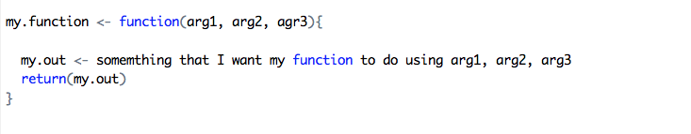
Writing Functions in R

Slide 3
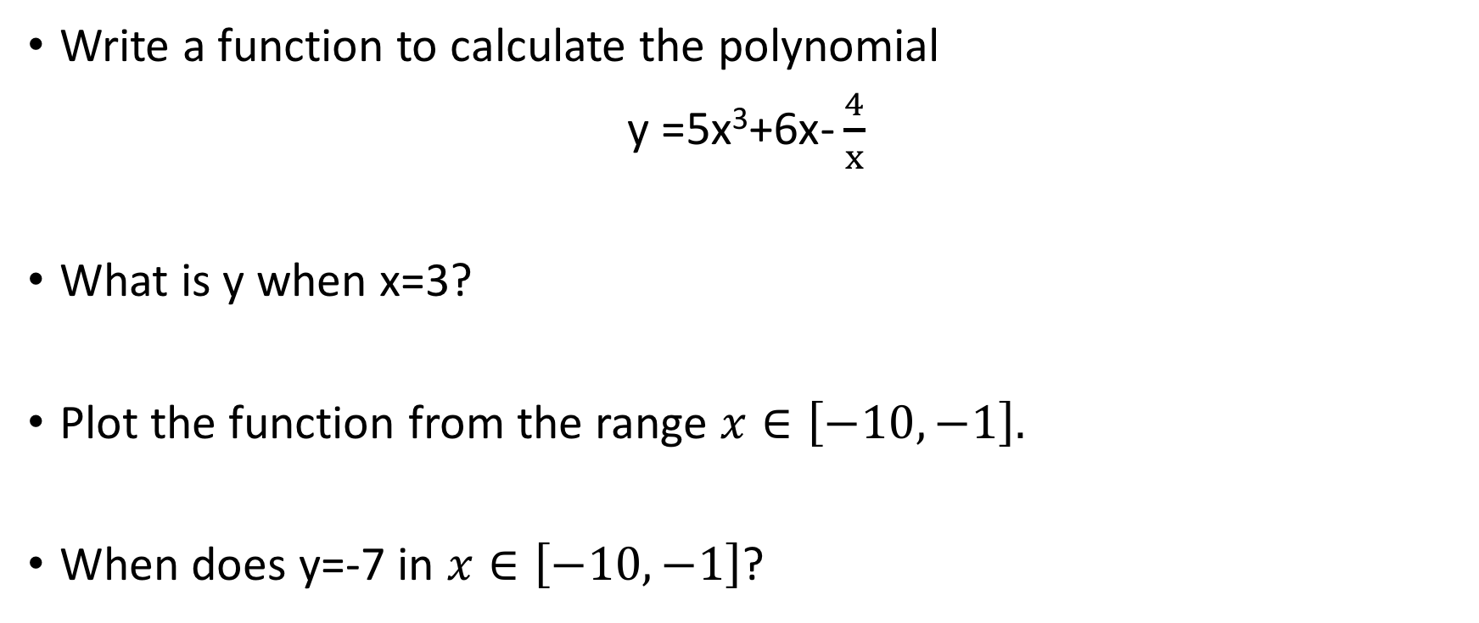
Writing Functions in R
Write a function to calculate the polynomial
y =$\text{5}\text{x}\text{3}\text{+6}\text{x}\text{−}\frac{4}{x}$
What is y when x=3?
Plot the function from the range $x∈\left[−10,−1\right].$
When does y=-7 in $x∈\left[−10,−1\right]$?

Slide 4
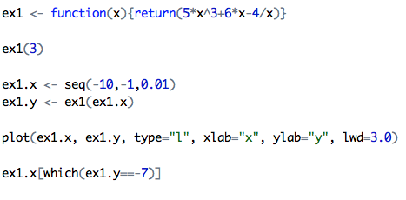
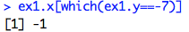

Writing Functions in R
y =$\text{5}\text{x}\text{3}\text{+6}\text{x}\text{−}\frac{4}{x}$

Slide 5
Mathematical Model vs. Statistical Model
Mathematical models use mathematical language to describe the behavior of the system.
Statistical models relate observed quantities to independent variables (predictors).

Slide 6
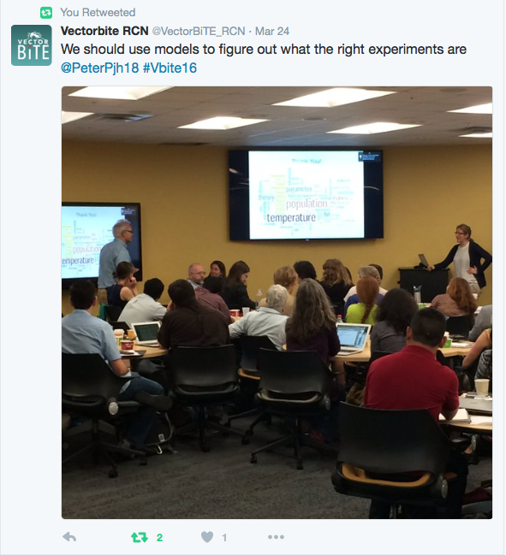
Ecological Modeling
Why do we describe populations through mathematical equations?
Can give us a insight into how specific forces may
influence a population over time.
What is the advantage(s) of doing this?
Simplify the world
Can allow us to focus in on specific components of the
real world.
What are some of the things you should keep in mind when developing or using models?

Slide 7
Diving into Mathematical Models
What is a population?
N

Slide 8
Dynamics
What is a population?
What can affect N?
+
-
N

Slide 9
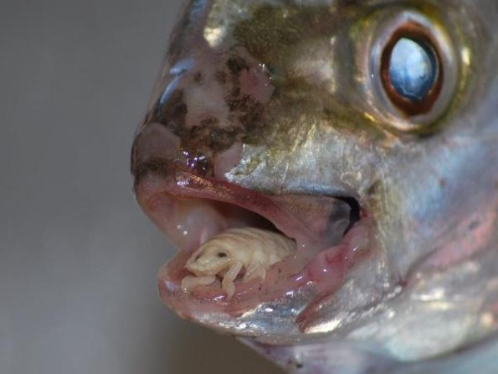
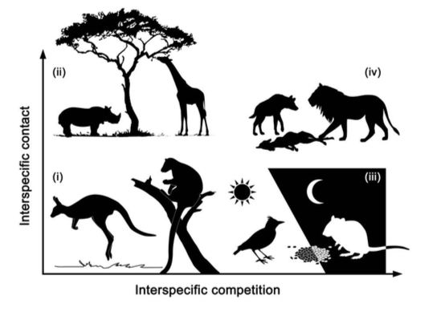

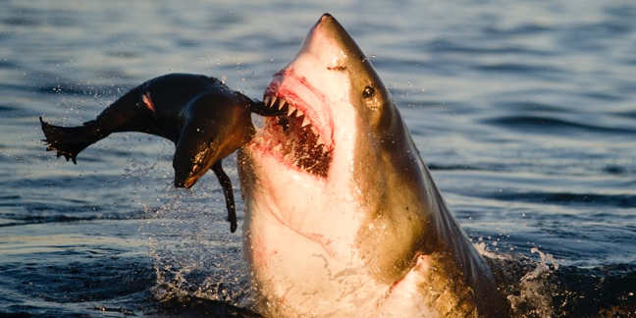
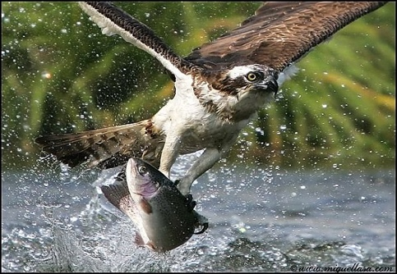
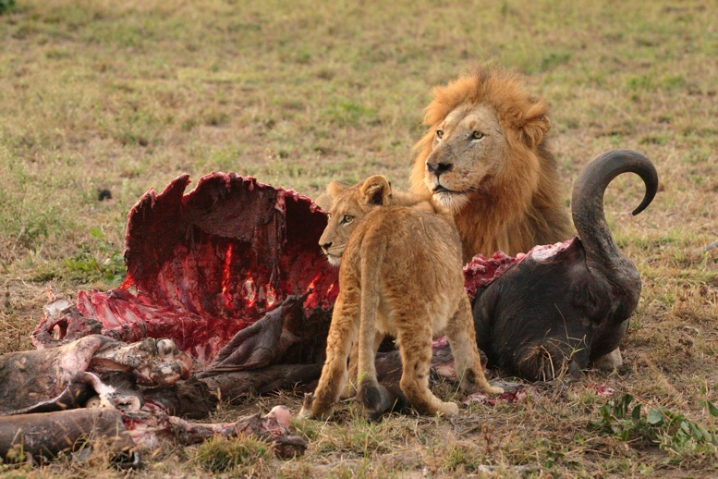
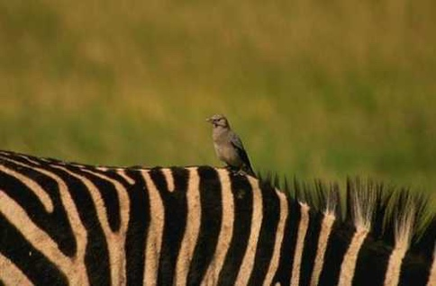
Dynamics
What is a population?
What can affect N?
+
-
N

Slide 10
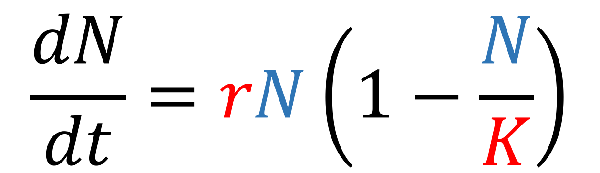
Anatomy of mathematical model
$$\frac{dN}{dt}=rN\left(1−\frac{N}{K}\right)$$
(State) Variable
Parameter

Slide 11
Discrete vs. Continuous Growth Models
Discrete
Continuous
Distinct time intervals/steps, i.e. 1, 2, 3, …T.
Can be used to describe populations with specific mating seasons that occur, or specific growth patterns.
Time is not in distinct intervals.
Population is continuously growing.
What would these types of models be used to describe?

Slide 12
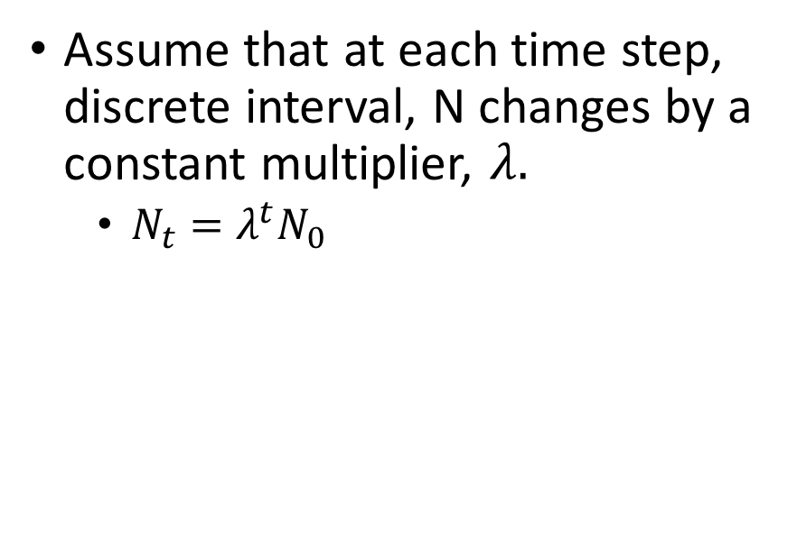
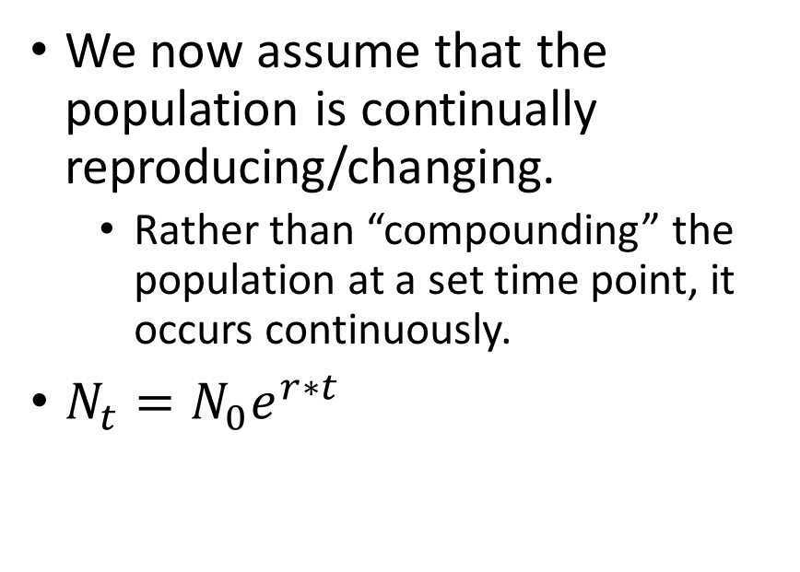
Geometric/Exponential Population Model
Discrete Time Model
Continuous Time Model
Assume that at each time step, discrete interval, N changes by a constant multiplier, $λ.$
$N_{t}=λ^{t}N_{0}$
We now assume that the population is continually reproducing/changing.
Rather than “compounding” the population at a set time point, it occurs continuously.
$N_{t}=N_{0}e^{r∗t}$

Slide 13
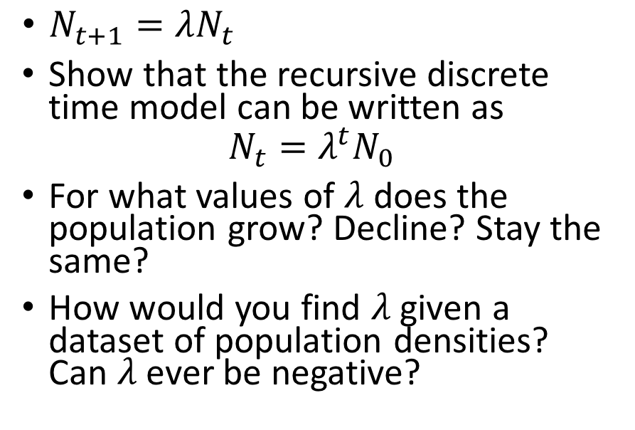
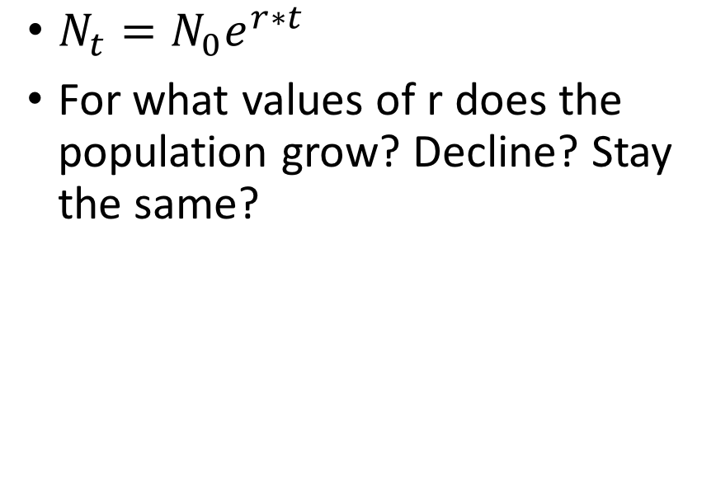
Geometric/Exponential Population Model
Discrete Time Model
Continuous Time Model
$N_{t+1}=λN_{t}$
Show that the recursive discrete time model can be written as
$$N_{t}=λ^{t}N_{0}$$
For what values of $λ$ does the population grow? Decline? Stay the same?
How would you find $λ$ given a dataset of population densities? Can $λ$ ever be negative?
$N_{t}=N_{0}e^{r∗t}$
For what values of r does the population grow? Decline? Stay the same?

Slide 14
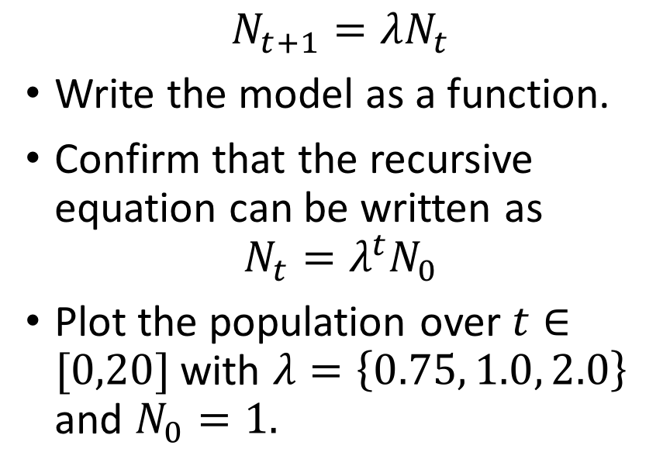
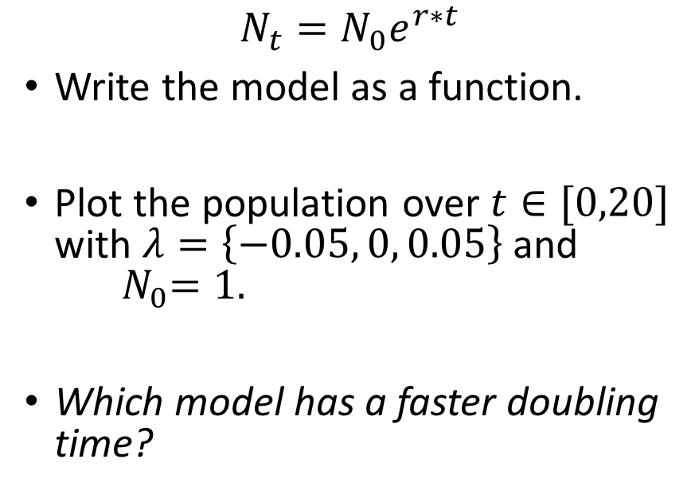
Geometric/Exponential Population Model
Discrete Time Model
Continuous Time Model
$$N_{t+1}=λN_{t}$$
Write the model as a function.
Confirm that the recursive equation can be written as
$$N_{t}=λ^{t}N_{0}$$
Plot the population over $t∈[0,20]$ with $λ=\left\{0.75, 1.0, 2.0\right\}$ and $N_{0}=1.$
$$N_{t}=N_{0}e^{r∗t}$$
Write the model as a function.
Plot the population over $t∈[0,20]$ with $λ=\left\{−0.05, 0, 0.05\right\}$and ${ N}_{0}=1.$
Which model has a faster doubling time?

Slide 15
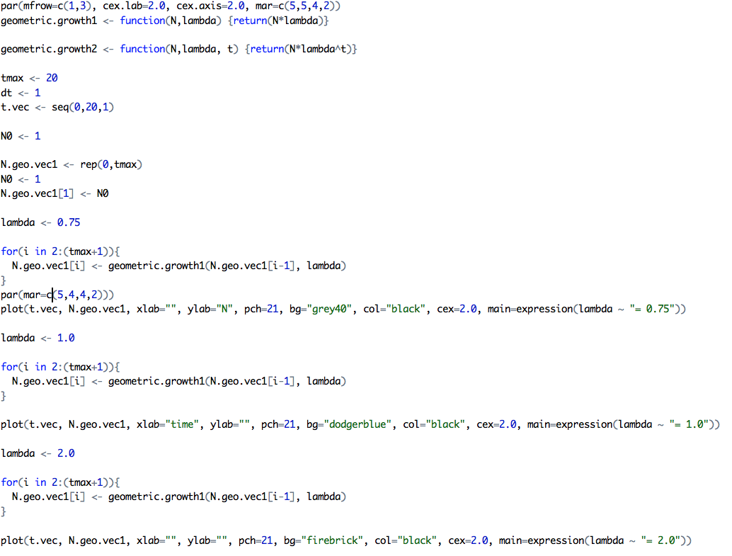
Geometric/Exponential Population Model

Slide 16
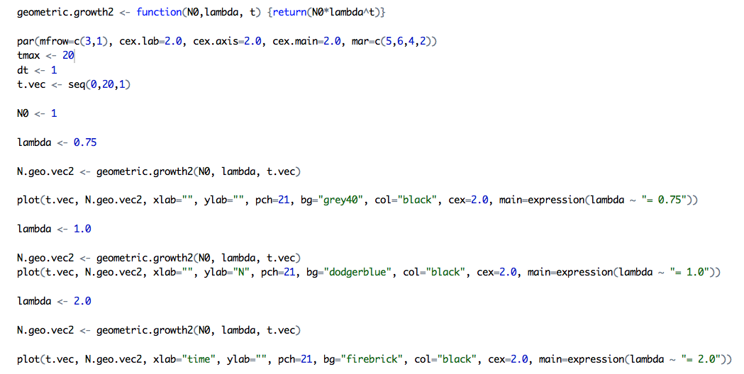
Geometric/Exponential Population Model

Slide 17
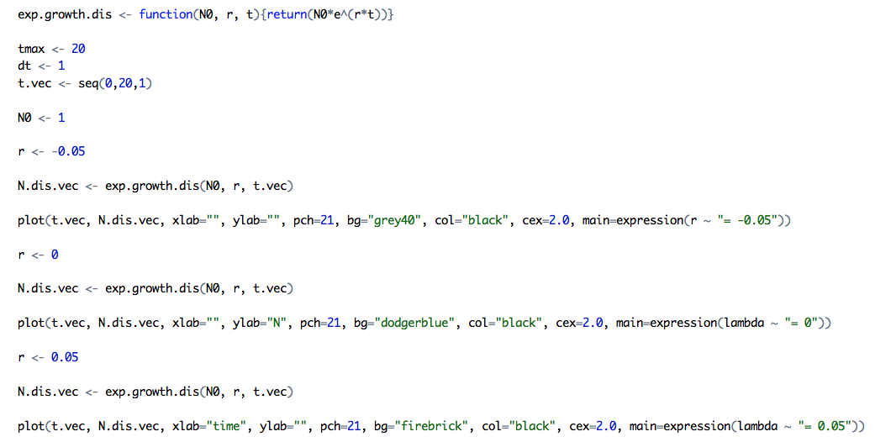
Geometric/Exponential Population Model

Slide 18
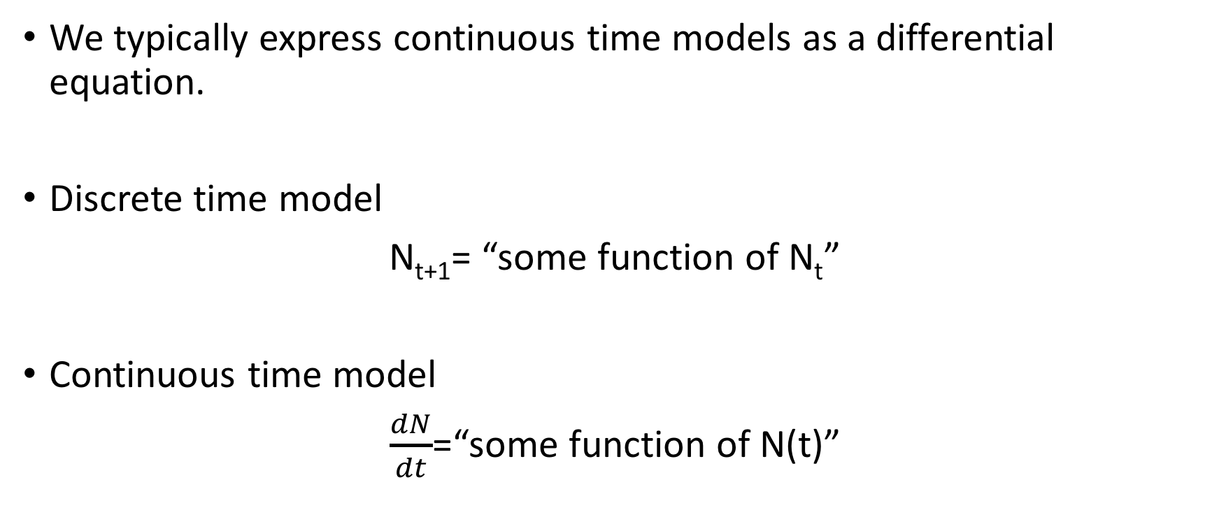
Continuous Growth Model
We typically express continuous time models as a differential equation.
Discrete time model
N_{t+1}= “some function of N_{t}”
Continuous time model
$\frac{dN}{dt}$=“some function of N(t)”

Slide 19
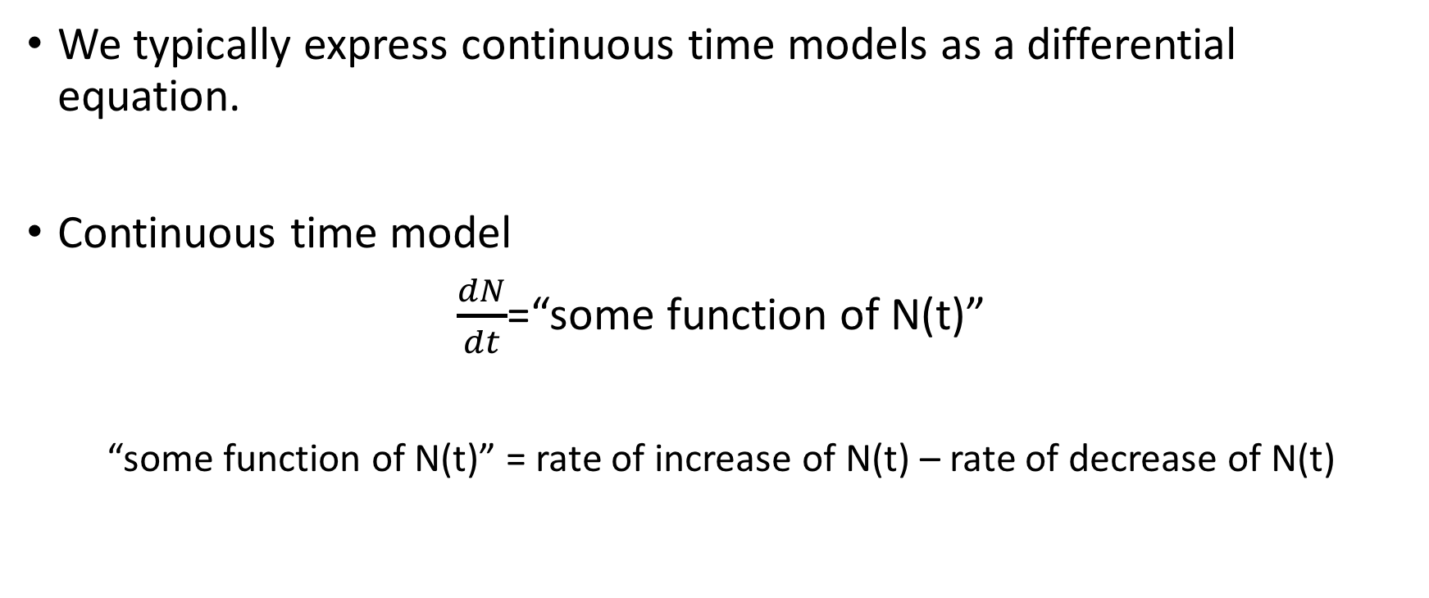
Continuous Growth Model
We typically express continuous time models as a differential equation.
Continuous time model
$\frac{dN}{dt}$=“some function of N(t)”
“some function of N(t)” = rate of increase of N(t) – rate of decrease of N(t)

Slide 20
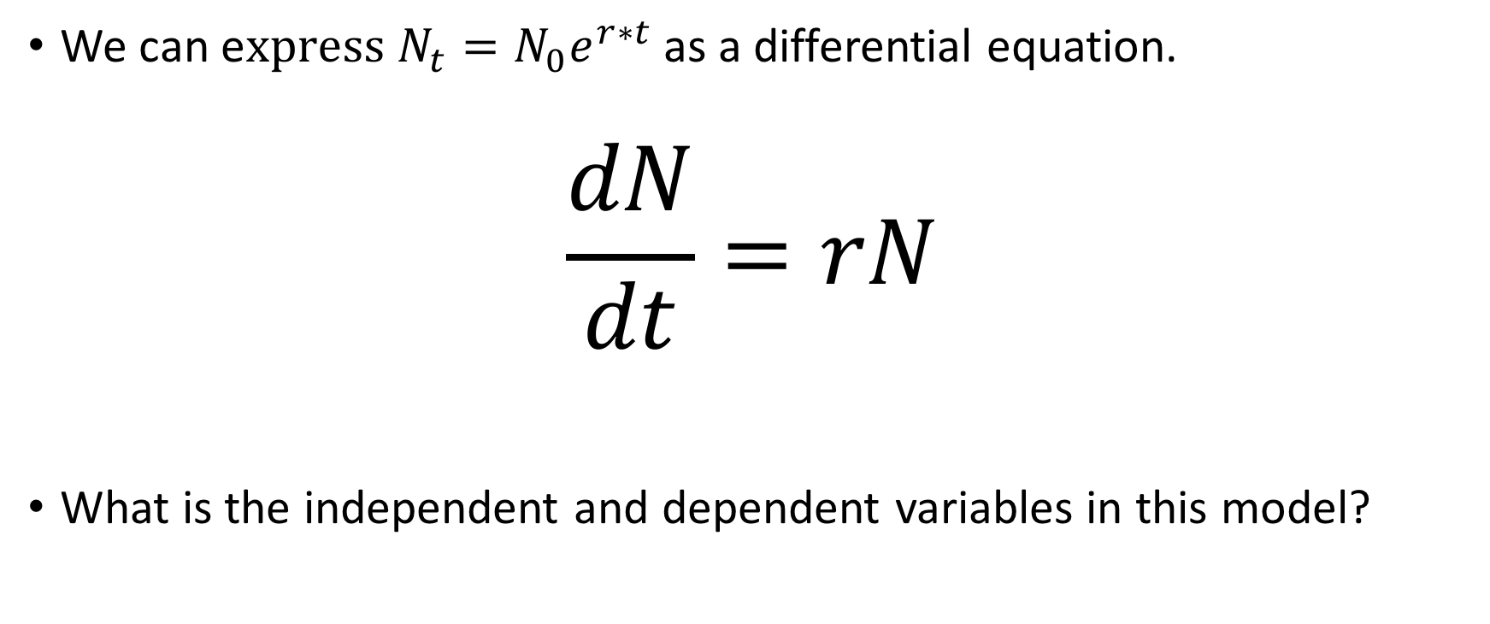
Continuous Growth Model
We can e$xpress N_{t}=N_{0}e^{r∗t}$ as a differential equation.
$$\frac{dN}{dt}=rN$$
What is the independent and dependent variables in this model?

Slide 21
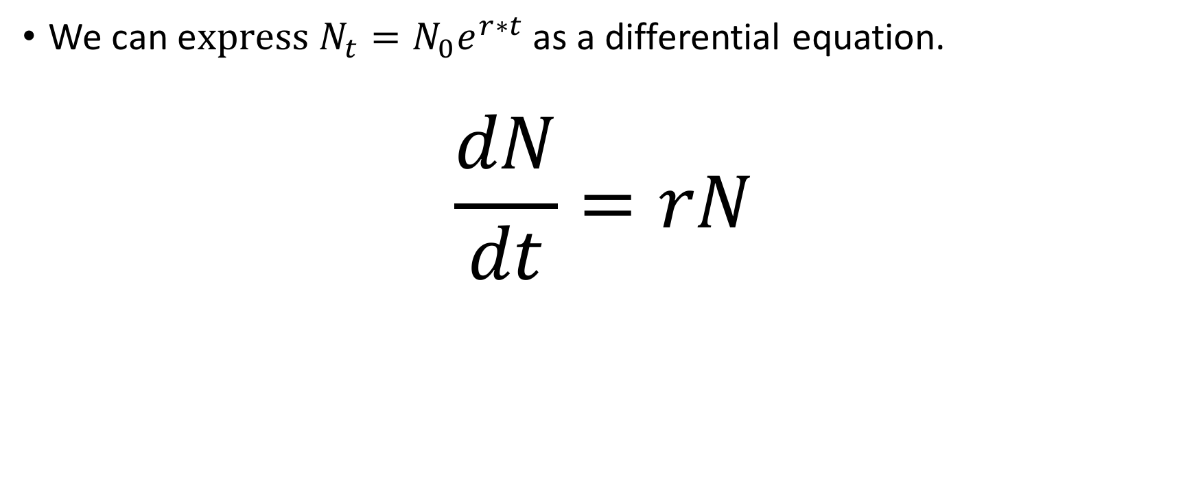
Continuous Growth Model
We can e$xpress N_{t}=N_{0}e^{r∗t}$ as a differential equation.
$$\frac{dN}{dt}=rN$$
The change in population size with respect to time.
Slope if N(t) was p

Slide 22
Continuous Growth Model
We can e$xpress N_{t}=N_{0}e^{r∗t}$ as a differential equation.
$$\frac{dN}{dt}=rN$$
State variable: describes the current state of the system (population size)

Slide 23
Continuous Growth Model
We can e$xpress N_{t}=N_{0}e^{r∗t}$ as a differential equation.
$$\frac{dN}{dt}=rN$$
Intrinsic growth rate: Growth parameter that can be broken down into per capita births (b₀) and per capita deaths (d₀) with r=b₀-d₀.

Slide 24
Continuous Growth Model
We can e$xpress N_{t}=N_{0}e^{r∗t}$ as a differential equation.
$$\frac{dN}{dt}=rN$$
Intrinsic growth rate: Growth parameter that can be broken down into per capita births (b₀) and per capita deaths (d₀) with r=b₀-d₀.

Slide 25
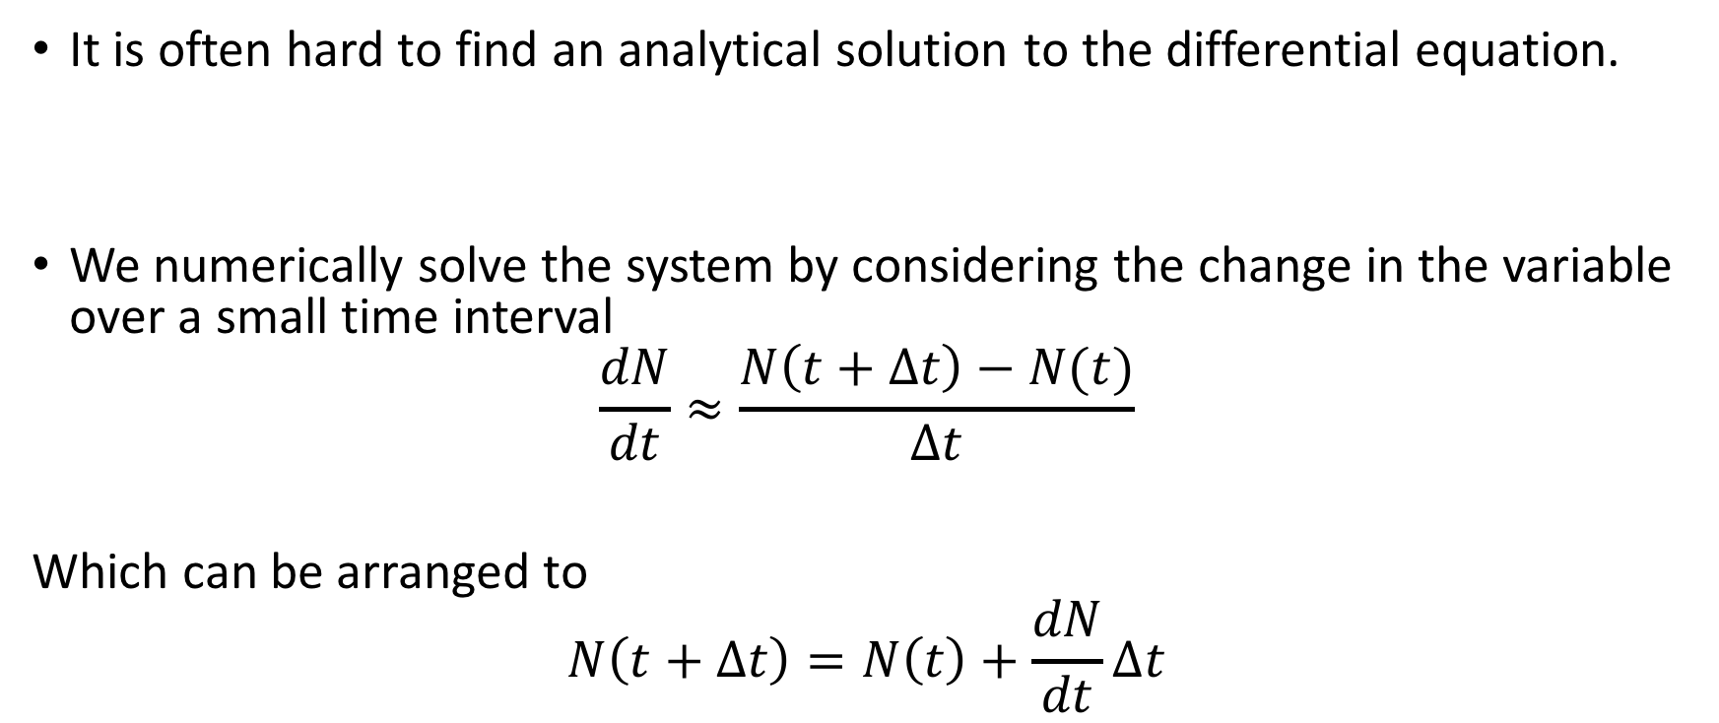
Solving Differential Equations in R
It is often hard to find an analytical solution to the differential equation.
We numerically solve the system by considering the change in the variable over a small time interval
$$\frac{dN}{dt}≈\frac{N\left(t+∆t\right)−N(t)}{∆t}$$
Which can be arranged to
$$N\left(t+∆t\right)=N\left(t\right)+\frac{dN}{dt}∆t$$

Slide 26
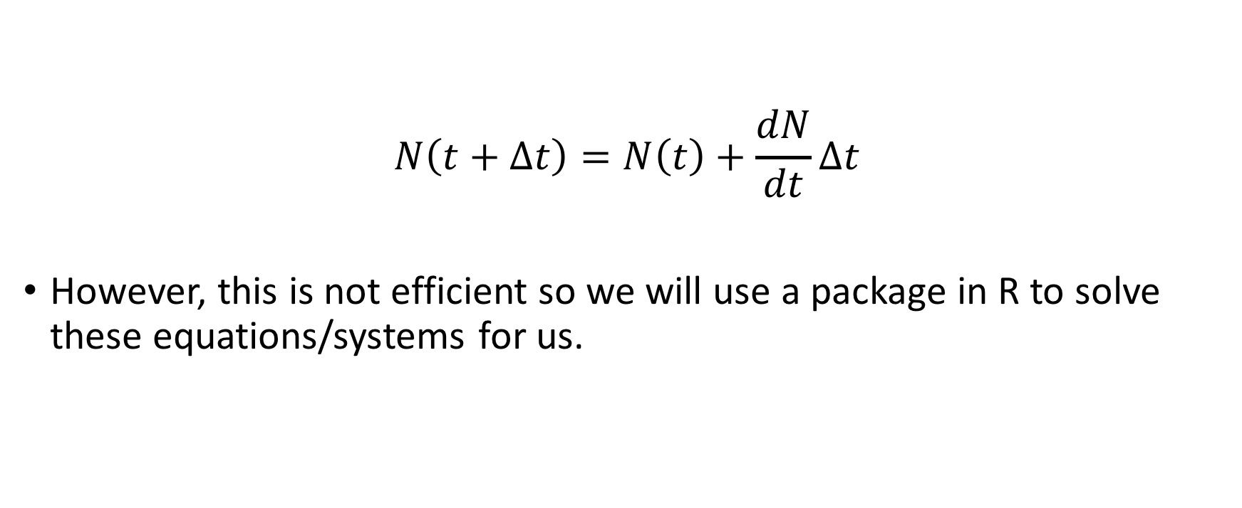
Solving Differential Equations in R
$$N\left(t+∆t\right)=N\left(t\right)+\frac{dN}{dt}∆t$$
However, this is not efficient so we will use a package in R to solve these equations/systems for us.

Slide 27
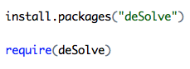
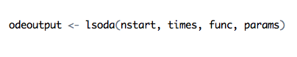
Solving Differential Equations in R
Loading in the deSolve
The function lsoda (Livermore Solver for Ordinary Differential Equations)

Slide 28
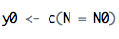
Solving Differential Equations in R
The function lsoda (Livermore Solver for Ordinary Differential Equations)
Initial conditions: a vector of initial variable values in the system.

Slide 29
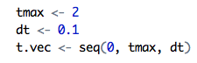
Solving Differential Equations in R
The function lsoda (Livermore Solver for Ordinary Differential Equations)
A vector of the times for function to return the values of the variables in the differential equations.

Slide 30
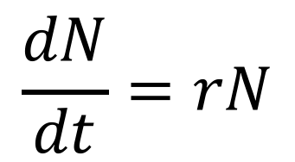
Solving Differential Equations in R
The function lsoda (Livermore Solver for Ordinary Differential Equations)
A function that is the right hand side of the differential equation system.
$$\frac{dN}{dt}=rN$$

Slide 31
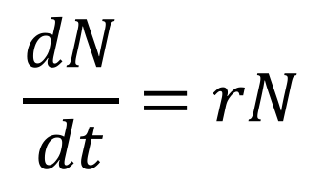
Solving Differential Equations in R
The function lsoda (Livermore Solver for Ordinary Differential Equations)
A vector of the parameters of the system.
$$\frac{dN}{dt}=rN$$

Slide 32
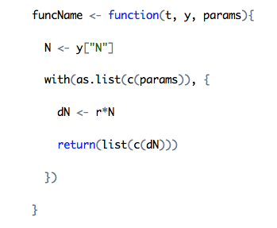
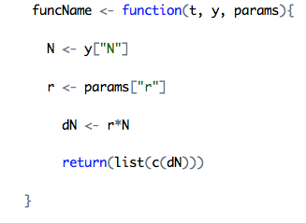
Solving Differential Equations in R
The func argument
The current time of integration/system.
Is not always used in the function but still needed when defining it.

Slide 33
Solving Differential Equations in R
The func argument
A vector of the current variables of the system
Always used.

Slide 34
Solving Differential Equations in R
The func argument
The parameters of the system. The same vector that is used in lsoda function.
Always used.

Slide 35
Solving Differential Equations in R
The func argument
The arguments of the function must be in that order.

Slide 36
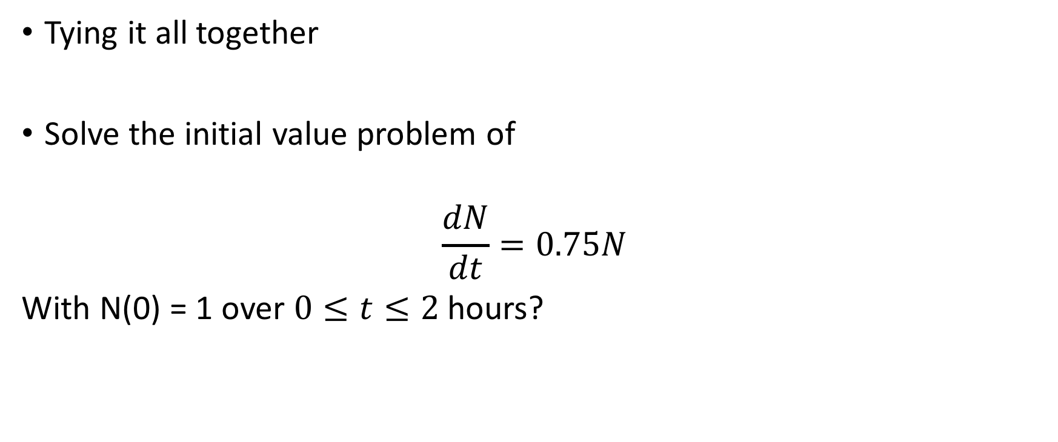
Solving Differential Equations in R
Tying it all together
Solve the initial value problem of
$$\frac{dN}{dt}=0.75N$$
With N(0) = 1 over $0≤t≤2$ hours?

Slide 37
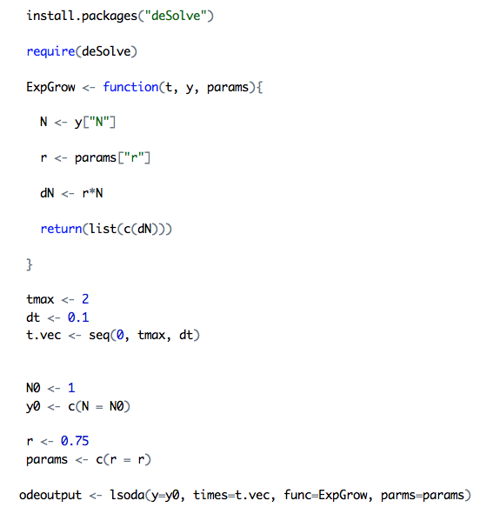
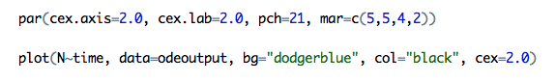
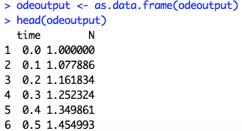
Solving Differential Equations in R
Tying it all together

Slide 38
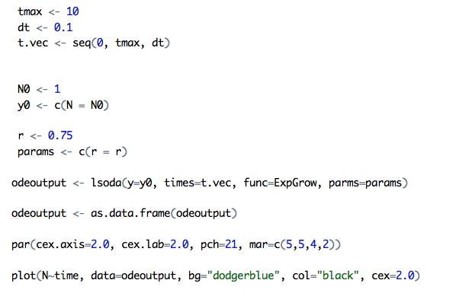
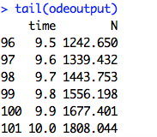
Solving Differential Equations in R
What does the population look like after 10 hours? What is the population size?

Slide 39
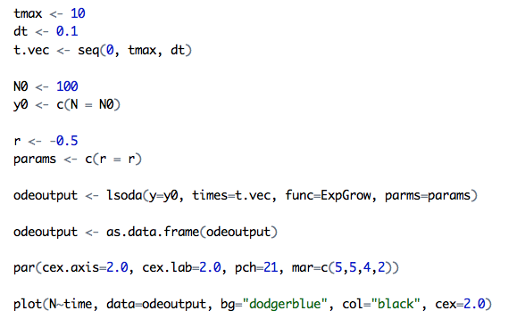
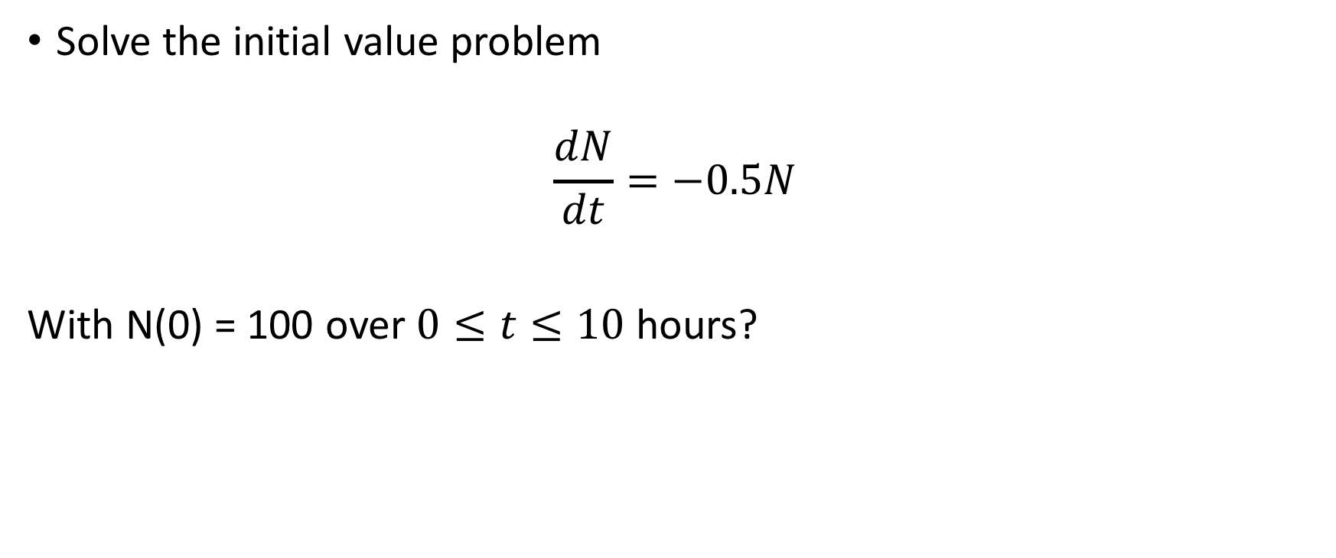
Solving Differential Equations in R
Solve the initial value problem
$$\frac{dN}{dt}=−0.5N$$
With N(0) = 100 over $0≤t≤10$ hours?

Slide 40
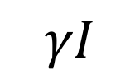
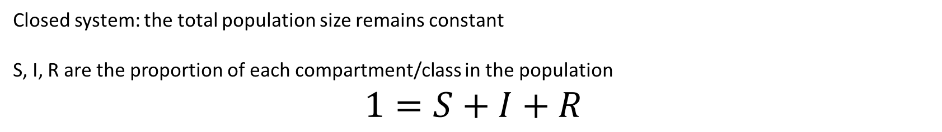
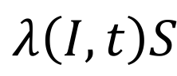
Infectious Disease Models
S
I
R
$$λ\left(I,t\right)S$$
$$γI$$
Infection
Recovery
Closed system: the total population size remains constant
S, I, R are the proportion of each compartment/class in the population
$$1=S+I+R$$

Slide 41
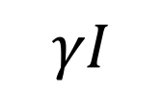
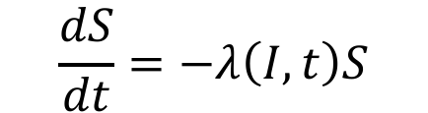
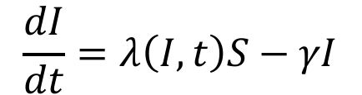

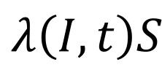
Infectious Disease Models
S
I
R
$$λ\left(I,t\right)S$$
$$γI$$
Infection
Recovery
$$\frac{dS}{dt}=−λ\left(I,t\right)S$$
$$\frac{dI}{dt}=λ\left(I,t\right)S−γI$$
$$\frac{dR}{dt}=γI$$

Slide 42


Force of infection $λ\left(I,t\right)$
Per capita rate that susceptible individuals become infected.
Influenced by:
Total population size (N)
Contact rate (number of contacts = C(N))
Probability of successful transmission per contact ($ε$)
Number of infected hosts (I)
Proportion of infected hosts ($\frac{I}{N}$)
We can break down the force of infection to:
$λ\left(I,t\right)$= contact rate x
probability of successful transmission x
proportion of infected individuals in the population

Slide 43



Force of infection $λ\left(I,t\right)$
Density dependent transmission
Frequency Dependent Transmission
Assume that contact scales with population size
$$λ\left(I,t\right)=c∗N∗ε∗I/N$$
$=c∗ε∗I$
$=β∗I$
Assume that contact overall does not change
$$λ\left(I,t\right)=κ∗ε∗I/N$$
$$=κ∗ε∗I/N$$
$$=β∗I/N$$

Slide 44







Infectious Disease Models in R
$$\frac{dS}{dt}=−λ\left(I,t\right)S$$
$$\frac{dS}{dt}=−β\frac{I}{N}S$$
$$λ\left(I,t\right)=β∗I/N$$
$$\frac{dI}{dt}=λ\left(I,t\right)S−γI$$
$$\frac{dI}{dt}=β\frac{I}{N}S−γI$$
$$\frac{dR}{dt}=γI$$
$$\frac{dR}{dt}=γI$$

Slide 45




Infectious Disease Models in R
$$\frac{dS}{dt}=−β\frac{I}{N}S$$
$$\frac{dI}{dt}=β\frac{I}{N}S−γI$$
$$\frac{dR}{dt}=γI$$

Slide 46




Infectious Disease Models in R
Set up time that you want variable for
Set up parameters
Set up initial conditions for variables
Implement the lsoda function

Slide 47

Infectious Disease Models in R

Slide 48

Infectious Disease Models in R

Slide 49
Outline Solving ODE in R
Write the system of equations as a function that will be used in the ODE solver function (func).
Set up the times that solutions are needed (times vector), initial conditions (y vector), parameters (parms vector).
Implement the lsoda function to solve the system. (Can also use ode included in the deSolve package).
Plot the results.
Once you have a script solving an ODE (system) you can easily modify it.

Slide 50


Extending the SIR model
$$γI$$
Recovery
S
I
$$λ\left(I,t\right)S$$
Infection

Slide 51




Extending the SIR model
$$bN$$
Births
S
I
R
$$λ\left(I,t\right)S$$
$$γI$$
Infection
$$μI$$
Recovery
$$μS$$
$$μR$$
Deaths
Deaths
Deaths

Slide 52








Reproductive ratio of the parasite (R₀)
The average number of susceptible individuals an average infected individual will infect in the next generation in a fully susceptible population.
Let’s derive it from our simple SIR model with density dependent transmission.
$$\frac{dS}{dt}=−βIS$$
$$1=\frac{βS}{γ}$$
$$0=βIS−γI$$
$$R_{0}=\frac{βN}{γ}$$
$$\frac{dI}{dt}=βIS−γI$$
$$\frac{dR}{dt}=γI$$
$$0=βIS−γI$$
$$γI=βIS$$

Slide 53



Reproductive ratio of the parasite (R₀)
Find the R₀ of a system with frequency dependent transmission.
Is there a threshold for invasion?
Does S₀ need to be a specific value for an outbreak to occur?
$$\frac{dS}{dt}=−β\frac{I}{N}S$$
$$\frac{dI}{dt}=β\frac{I}{N}S−γI$$
$$\frac{dR}{dt}=γI$$

Slide 54
Chain Binomials
Stochastic model integrates stochastic events (unpredictable, associated with a random variable). Can predict the probability of a particular outcome in the future.
Random variable is a variable that is randomly distributed according to a probability distribution.
(Bernoulli) trail is an experiment that has only two outcomes.
Infection of a susceptible individual from an infected.

Slide 55

Binomial distribution
Suppose we toss a coin n times, what is the probability that in those tosses results in k heads?
When we toss the coin, it has a probability (p) that it results in heads.
Each toss (trail) is an independent event.
The result of a previous coin toss does not affect the outcome of the next.
The probability of observing the outcome is the product of each individual trail.
There are multiple ways that we can observe the outcome, so we need to include the number of ways we can observe that.
$Prob\left[X=k\right]=\left({n \atop k}\right)p^{k}{(1−p)}^{n−k}$ where $\left({n \atop k}\right)=\frac{n!}{k!\left(n−k\right)!}$
What is the probability of observing 3 heads when is a biased coin is tossed 3 times? The probability of observing a heads in a toss is 0.3.

Slide 56

Reed-Frost chain binomial model
Susceptible individuals are converted to infected in discrete, non-overlapping time intervals.
S_{t} and I_{t} are discrete taking a non-negative integer from 0 to N.
Let q be the probability of contact with an infected individual and $β$ be the probability of infection when contacting an infected individual.
Probability an susceptible individual escapes infection from an infected individual ($α)$:
$$\left(1−q\right)+q\left(1−β\right)=α$$
Probability that they do not interact with a infected
Probability they interact with an infected but does not get infected.

Slide 57

Reed-Frost chain binomial model
Time is discrete and the time step is equal to infectious period.
The compartments are also discrete.
At the next time step (t+1), the sum number of infected individuals and the number of susceptible individuals is the number of susceptible individuals in the previous step ($S_{t}=S_{t+1}+I_{t+1})$.
In a single time step, a susceptible individual can either become infected or escape infection from an infected individual.
A susceptible individual is still susceptible in the next time step unless they contact an infected and successful transmission occurs.

Slide 58

Reed-Frost chain binomial model
$$S_{t+1}\sim binomial\left(S_{t},p\right)$$
$S_{t}:$ The number of susceptible individuals
p: The probability of escaping infection from every infected individual
$$p= α∗α∗α∗…∗α=α^{I_{t}}$$

Slide 59





Reed-Frost chain binomial model
$S_{t+1}=binomial(S_{t},α^{I_{t}}$)
$$I_{t+1}=S_{t}−S_{t+1}$$
Define $α$
Set the initial conditions
Set the start time and the output structure

Slide 60

Reed-Frost chain binomial model
Simulate an outbreak

Slide 61

Reed-Frost chain binomial model
What questions can you ask using this model?

Slide 62









Challenge Yourself
$$\frac{dN}{dt}=rN\left(1−\frac{N}{K}\right)$$
What are the assumptions of the model?
Are these realistic?
What is the long term behavior?
Does it reach an equilibrium?
What analytically can you solve
about the system?
What happens when you change the
parameters?
How can you modify it?
What question(s) can you answer by
doing this?
Implement it.
$$\frac{dS}{dt}=−β\frac{I}{N}S$$
$$\frac{dI}{dt}=β\frac{I}{N}S−γI$$
$$\frac{dS}{dt}=−βIS$$
$$\frac{dR}{dt}=γI$$
$$\frac{dI}{dt}=βIS−γI$$
$$\frac{dR}{dt}=γI$$

